Slide 1
Robustness of Image Captioning Models Against Adversarial Examples
Ananth Chillarige, Kevin Lee, Shrijesh Siwakoti

Slide 2
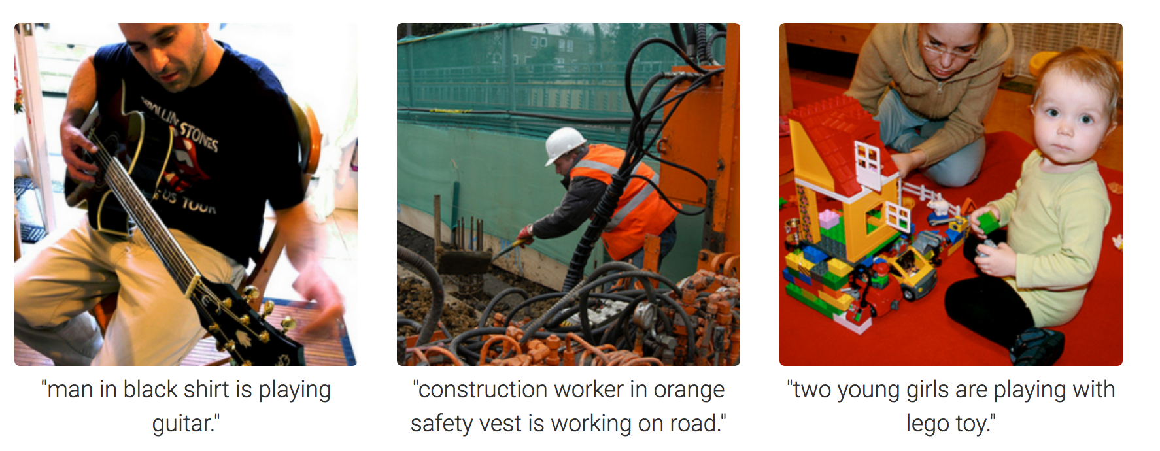
Why do we care about Image Captioning?
Notes:
Ananth

Slide 3
Problem
Most research is focused on detecting adversarial examples because classifying them is too hard
Most research is driven on the same 3 datasets (MNIST, CIFAR-10, Fashion MNIST) but not expanded on other image datasets
Many attacks and defenses are based on arbitrary concepts
Never look into the robustness of image-captioning models because black-box and semi-black box attacks are not as effective

Slide 4
Related Work
Chen et al [1]:
a CNN for image feature extraction and an RNN for caption generation
Show and Fool adversarial examples that look similar to natural images with randomly targeted captions/key words
Shetty et al [4]:
Use adversarial examples along with a gumbel sampler to achieve image captioning nearly indistinguishable from human generated captions
Xu et al [5]:
Fooled image captioning models using image distortion as well as fully and partially targeted captions with no relevance to images
Goodfellow et al [2]:
Used FGSM to create perturbations that affect classification models
Madry et al [3]:
Established PGD as universal first order adversary to create the most robust networks on MNIST and CIFAR-10
[1] Hongge Chen, Huan Zhang, Pin-Yu Chen, Jinfeng Yi,and Cho-Jui Hsieh. 2018. Attacking visual language grounding with adversarial examples: A case study on neural image captioning
[2] Ian J. Goodfellow, Jonathon Shlens, and ChristianSzegedy. 2015. Explaining and harnessing adversarial examples.
[3] Aleksander Madry, Aleksandar Makelov, Ludwig Schmidt, Dimitris Tsipras, and Adrian Vladu. 2019. Towards deep learning models resistant to adversarial attacks.
[4] Rakshith Shetty, Marcus Rohrbach, Lisa Anne Hendricks, Mario Fritz, and Bernt Schiele. 2017. Speaking the same language: Matching machine to humancaptions by adversarial training.
[5] Yan Xu, Baoyuan Wu, Fumin Shen, Yanbo Fan, YongZhang, Heng Tao Shen, and Wei Liu. 2019. Exactadversarial attack to image captioning via structuredoutput learning with latent variables.

Slide 5
Methodology: Captioning Model
Trained on Flickr8k dataset
3 main segments:
Photo Feature Extractor: Pretrained VGG16 model on ImageNet extracts image features
Sequence Processor: Word embedding layer and LSTM RNN
Decoder: Dense Layer to make prediction based on photo feature and sequence processor vectors

Slide 6
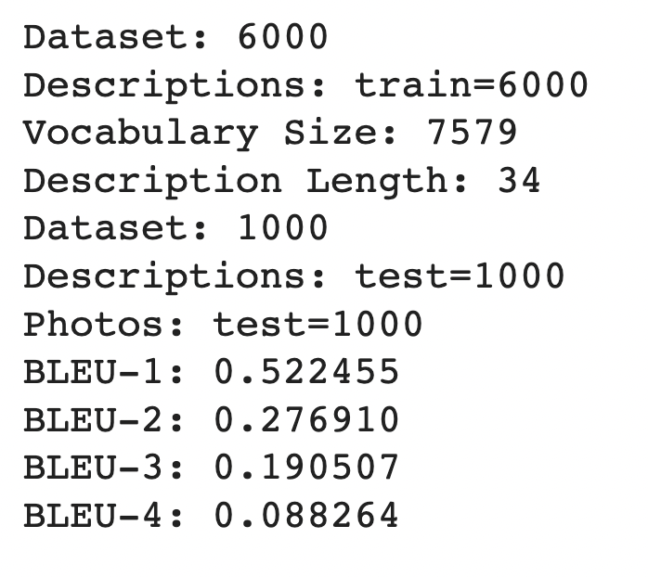
Results: Model

Slide 7
Methodology: Attacks
Focussed on attacking the photo feature extraction stage (VGG16)
Selected 20 images from validation data:
Ran FGSM for 100 epochs, epsilon = 0.01
Ran PGD 10 times, epsilon = 0.01
Wanted to see how the attacks impact BLEU Scores

Slide 8
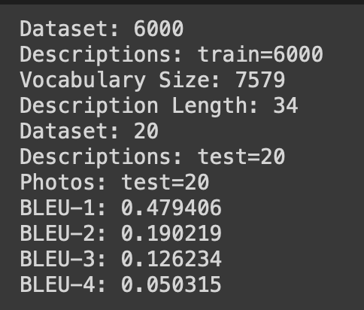
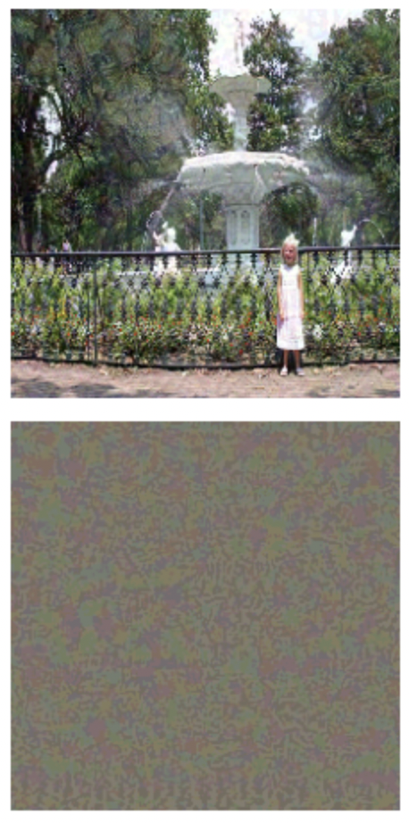
Results: FGSM

Slide 9
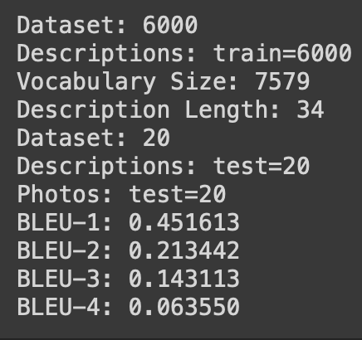
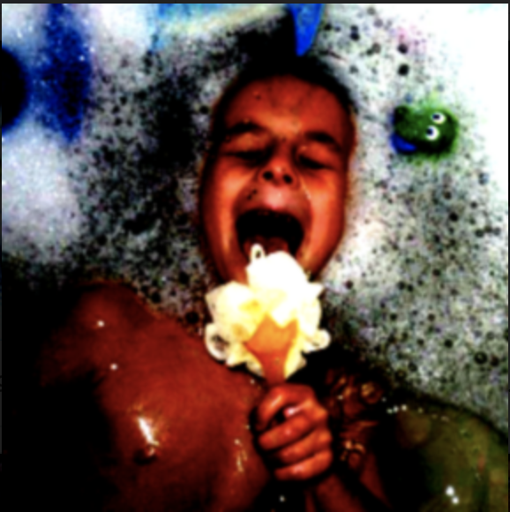
Results: PGD

Slide 10
Roadblocks
Google drive would not save the entirety of the dataset from google colab because google colab would often unsync
Google Colab Pro was purchased but still not enough to run through our code without timing out and we were nearly forced to pay $299/month for an upgraded tier of google colab pro
Great Lakes cluster would not load many of the needed modules to create our image-captioning model, FGSM attack, and PGD attacks
AWS EC2 would not open nor run properly + it is extremely expensive once the basic tier is used up
We tried an external GPU to run our code faster but it was not compatible with Windows Surface or Macbook Pros

Slide 11
Conclusion
Our results found that image-captioning models are more robust to adversarial examples than a regular image classification model with a semi-blackbox attack
This field of research is relatively new and therefore not much research has been done to further support our findings
More datasets must should be labeled using different models in order for optimized research

Slide 12
Future Work
Train captioning model on more data for higher performance
Full White Box attack that also attacks the LSTM, Object Detection, and sequence decoding layers
We did not explore LSTM and the decoding layers for attack
Test using other datasets like MS COCO
Uncover the blackbox nature of CNNs in order to truly understand why attacks affect different aspects of object detection

